Slide 1
Functions

Slide 2
A relation can be shown in various ways and the domain and range can be determined from each.

Slide 3
A relation can be shown in various ways and the domain and range can be determined from each.

Slide 4
A relation can be shown in various ways and the domain and range can be determined from each.
Domain
Range
Input values
Output values
Possible values for INDEPENDENT variable
Possible values for DEPENDENT variable
x values
y values

Slide 5
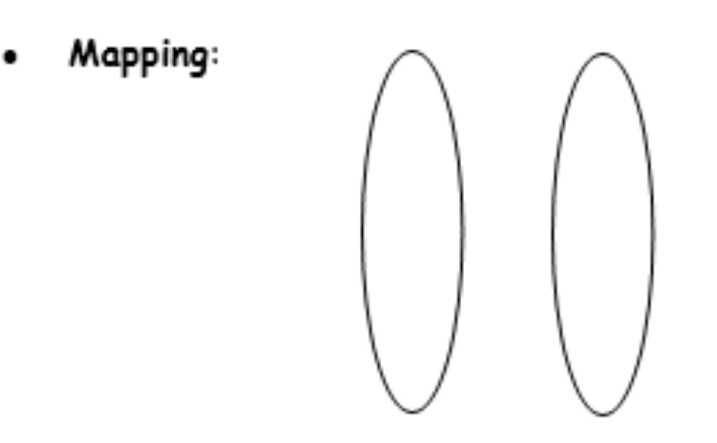
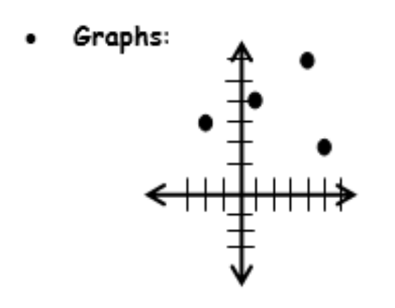
A relation can be shown in various ways and the domain and range can be determined from each.

Slide 6
FUNCTIONS
Relation: There is a relationship between two variables
Ex: Age and height
Amount of sleep and sluggishness
What is a function?
A relation/equation where there is EXACTLY one y for every x
Function: A relation between two variables such that for each independent variable x, there is AT MOST one dependent variable y. The notation f(x) = y emphasizes the one-to-one relationship between the independent and dependent variables.

Slide 7
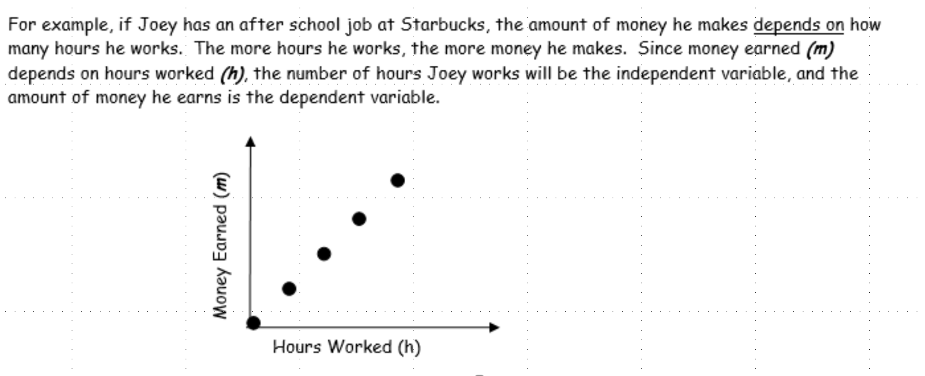
Remember, the independent variable is the one that drives the action.
The dependent variable only functions because of the independent variable.
Nothing would happen to the dependent variable without being influenced by the independent variable.

Slide 8
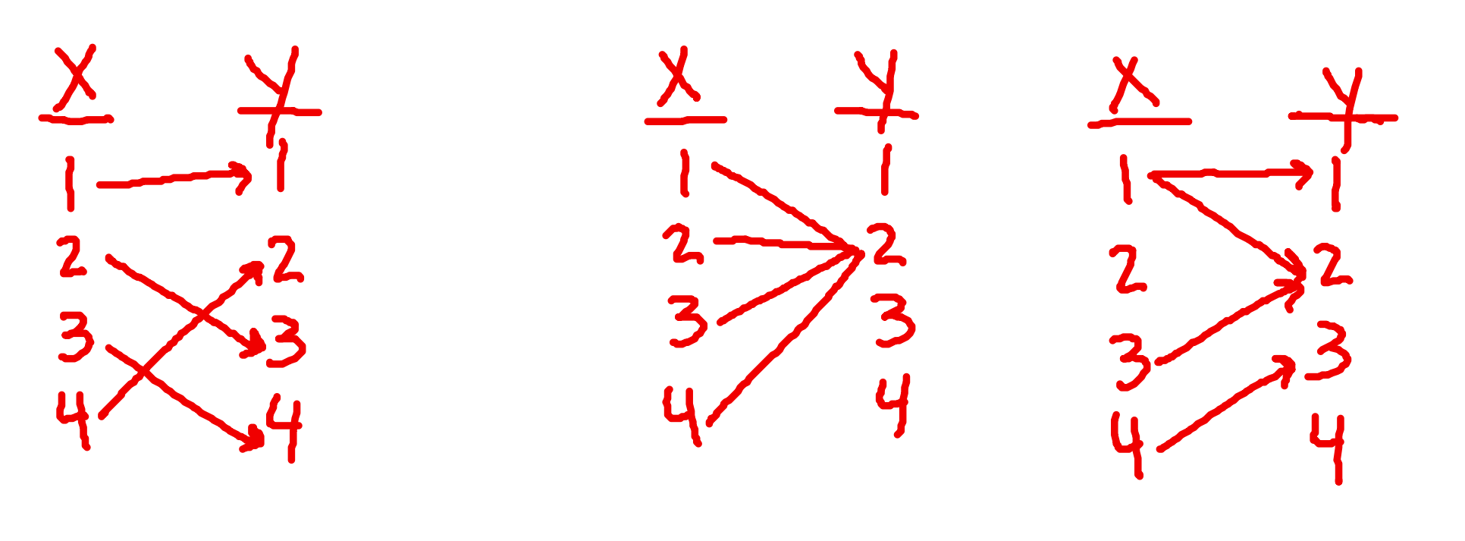
Thumbs up if you think yes, thumbs down if you think it is not.
Yes,
Every x only has 1 y
Yes,
Every x only has 1 y
No,
x at 1 has two y values

Slide 9
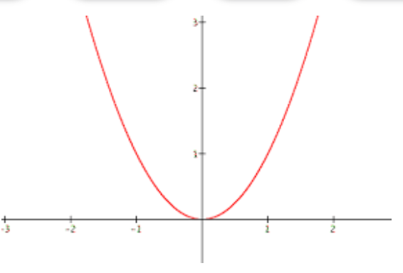
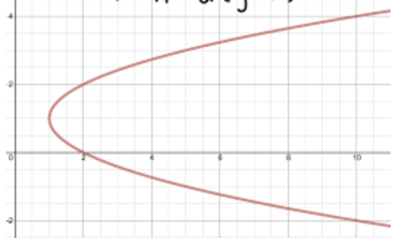
We can use the “Vertical Line” test to determine if a relation is a function.
Is a function – vertical line only intersects once
Is NOT a function – vertical line intersects twice!

Slide 10
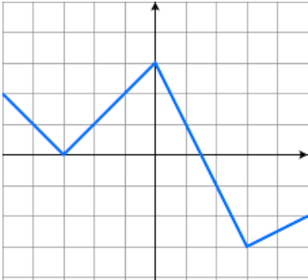
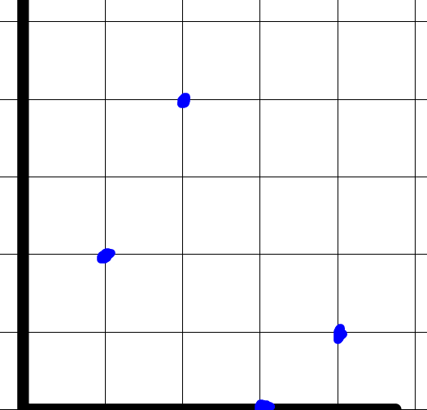
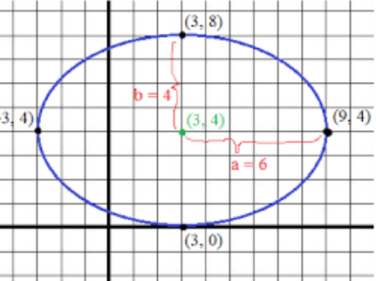
Function or not?
Yes
No
yes

Slide 11
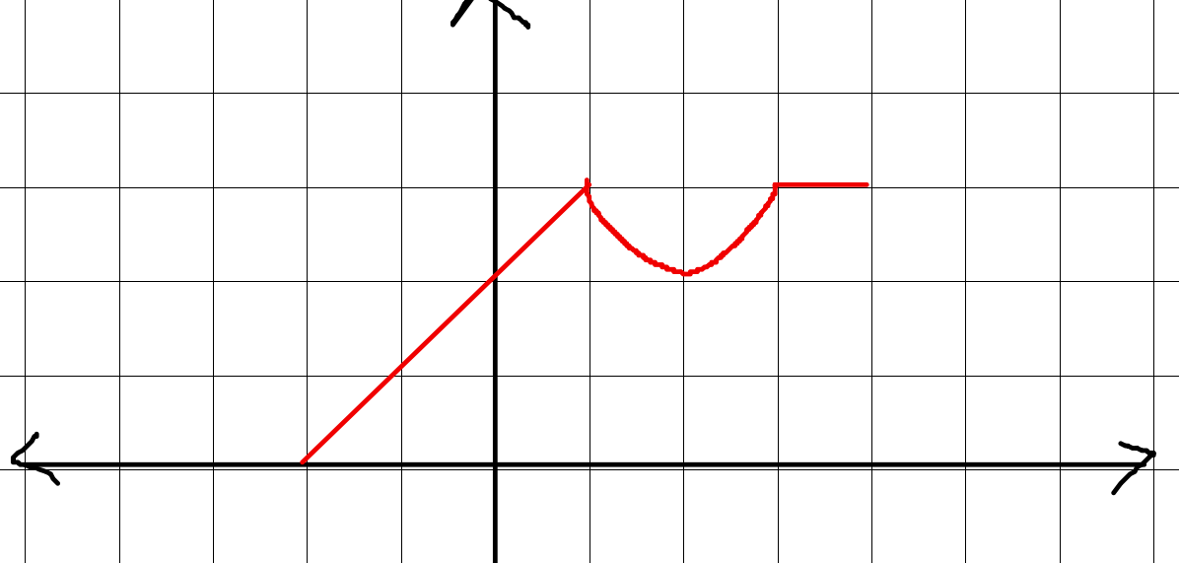
Find g(1)
3
g(x)
Find g(-2)
0

Slide 12
Inequality Notation:
Numerical representation of data using inequalities to specify the inclusion/exclusion of numbers
< > ≤ ≥
-3 ≤ x < 5
Interval Notation:
Numerical representation of data using brackets/parentheses to specify the inclusion/exclusion of numbers using ( ) [ ]
( ) – exclusion
[ ] – inclusion
[-3, 5)
-4 -3 -2 -1 0 1 2 3 4 5 6

Slide 13
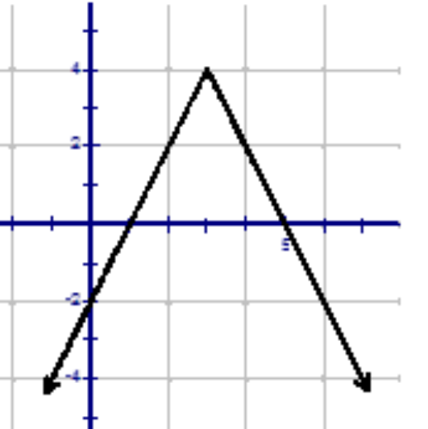
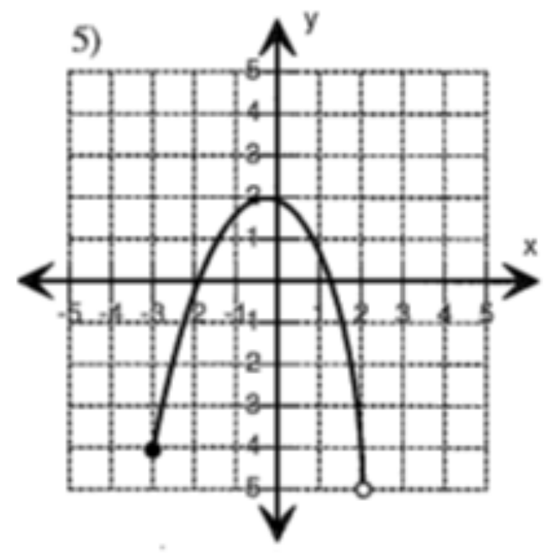
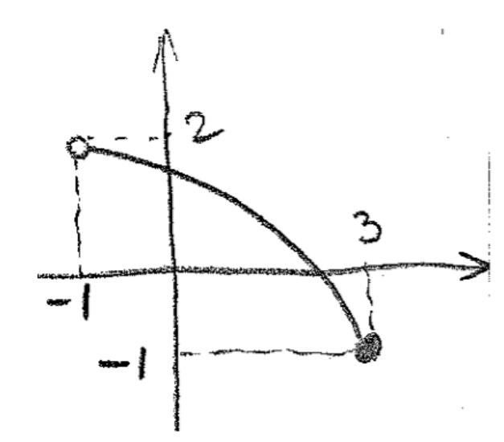
Using inequality notation, describe the domain and range of these graphs
{(-1,3)(1,-2)(3,1)(4,-5)}
D: -∞< x < ∞
R: -∞ < y ≤ 4
D: -3 ≤ x < 2
R: -5 < y ≤ 2
D: -1 < x ≤ 3
R: -1 ≤ y < 2
D: {-1, 1, 3, 4}
R: {-5, -2, 1, 3}

Slide 14
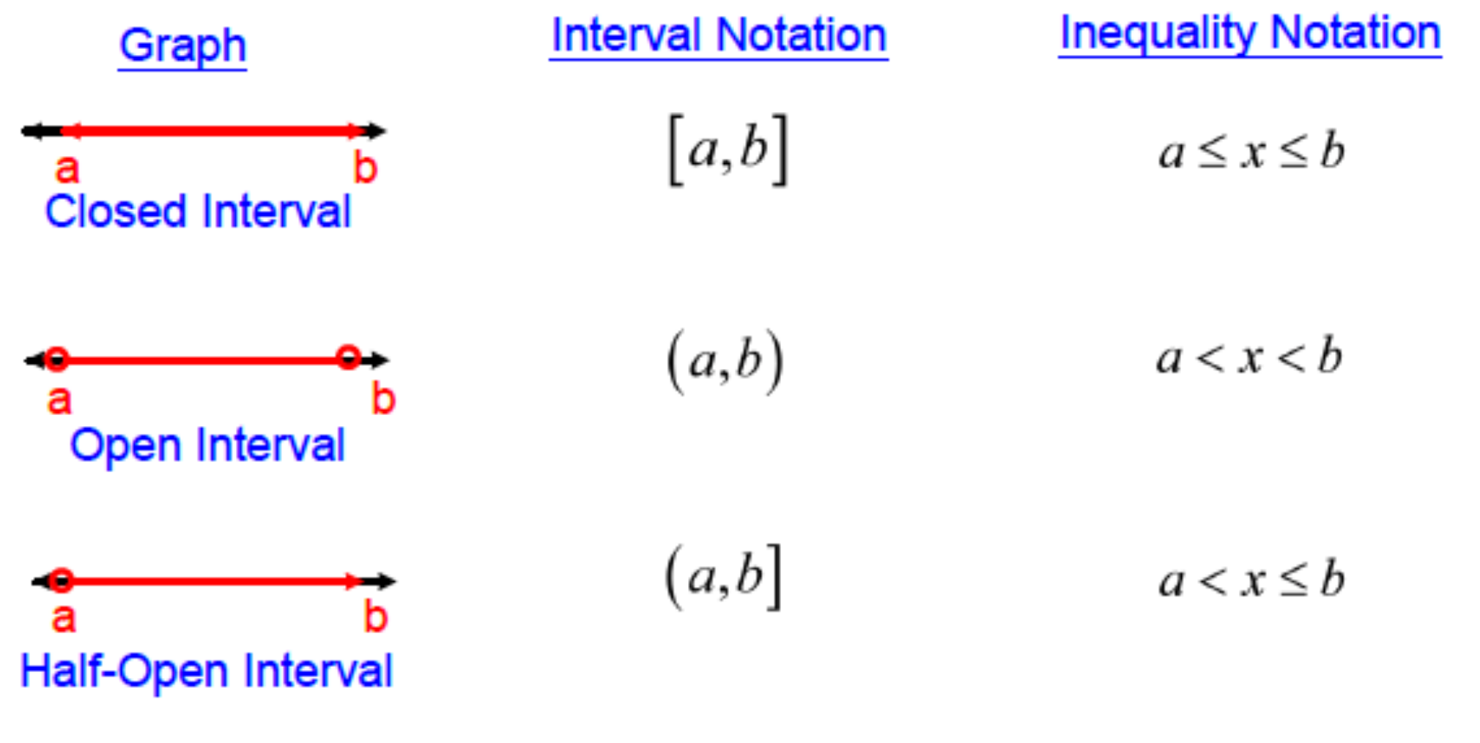

Slide 15
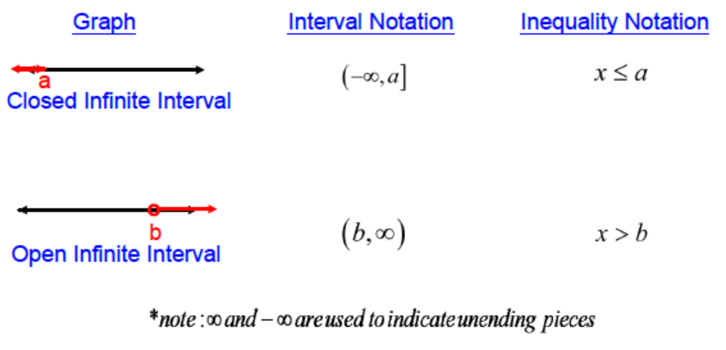

Slide 16
Find the domain using interval notation
(-∞, ∞)
[-3, 2)
(-1, 3]

Slide 17
Given the function $f\left(x\right)=\frac{2x+5}{x−3}$
Find f(1)
f(1)=$\frac{2\left(1\right)+5}{1−3}=−\frac{7}{2}$
$$f\left(t\right)=\frac{2t+5}{t−3}$$
Find f(t)
$$f\left(r+4\right)=\frac{2\left(r+4\right)+5}{\left(r+4\right)−3}=\frac{2r+13}{r+1}$$
Find f(r+4)

Slide 18
Homework: Worksheet
The key will be posted as well. Be sure to correct your assignment. Follow the HW procedure!

